Slide 1

Using Value-Focused Thinking for
Capabilities-Based Planning
Dr. Gregory S. Parnell, CSEP, Colonel, USAF, Retired
Professor of Practice
Director, M.S. in Operations Management
Director, M.S. in Engineering Management
University of Arkansas
Department of Industrial Engineering

Slide 2
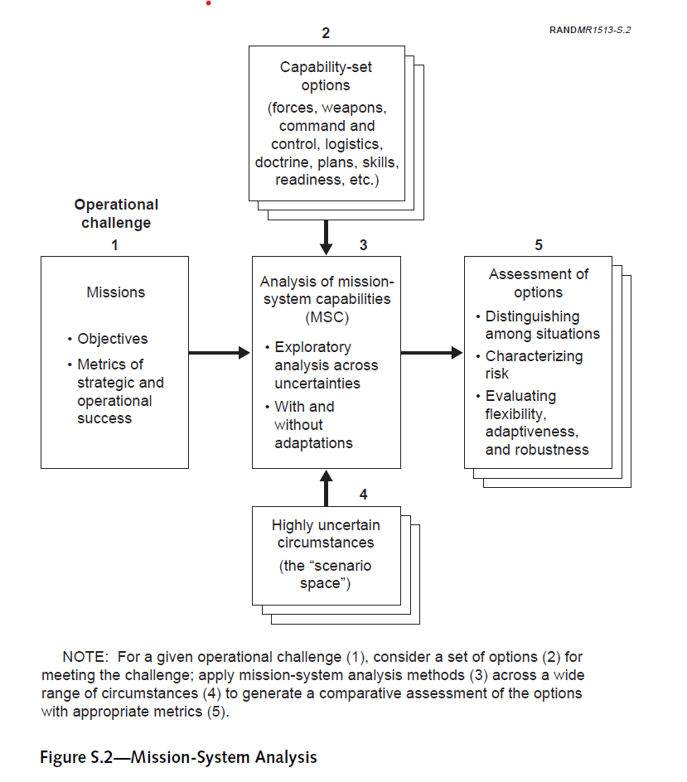
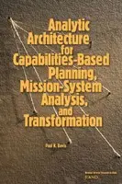
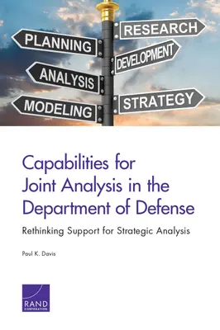
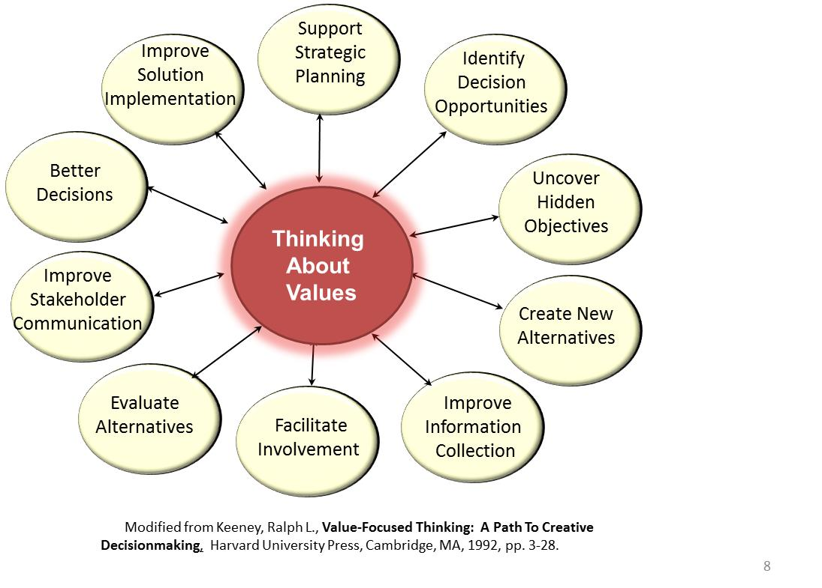
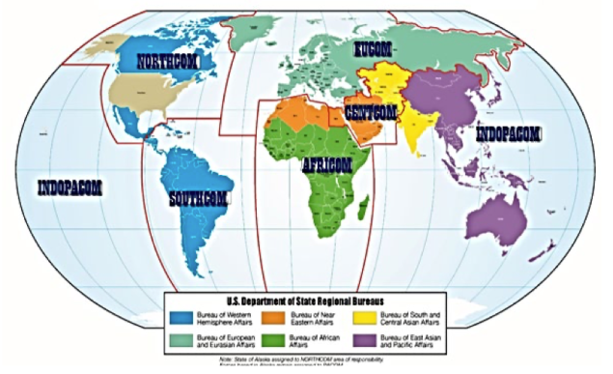
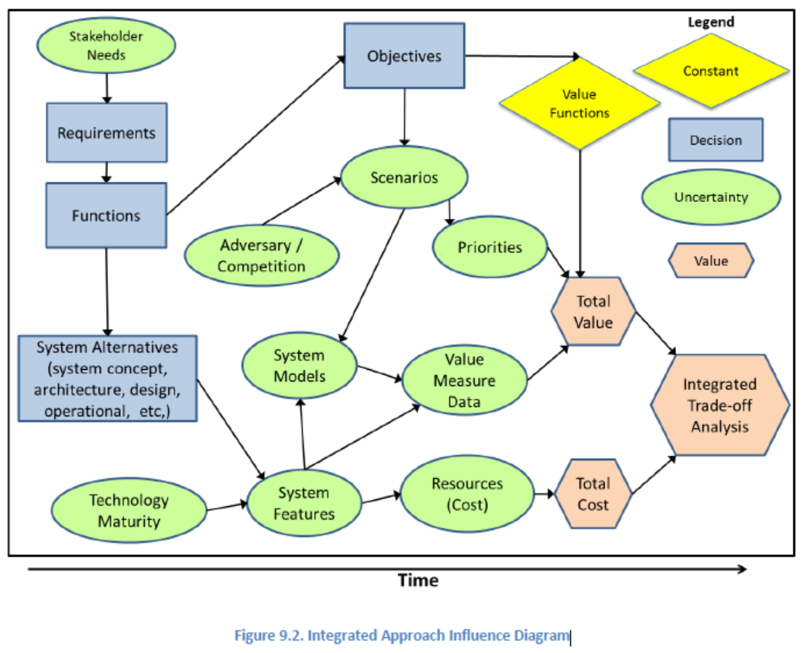
Bottom Line Up Front
Post Cold War Strategy for Resource Allocation
Capabilities-Based Planning
Value-Focused Thinking
Value Models
Integrated Analysis Models
Trade-Off Analytics

Slide 3
What is your background?
Strategic Planning
Scenario Based Planning
Capabilities-Based Planning
Modeling and Simulation
Value-Focused Thinking

Slide 4
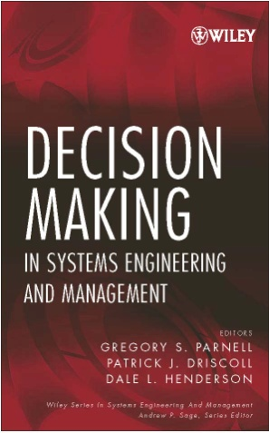


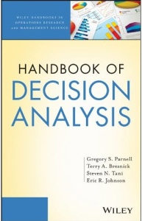
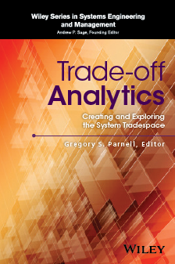
My Decision Analysis Research and Publications
Articles published
Operations Research
Management Science
Interfaces
Risk Analysis
Decision Analysis
Journal of Multi-criteria Decision Analysis
International Journal of Operations and Production Management
Systems Engineering
Systems
Military Operations Research
Engineering Management
Engineering Management Research
Naval-Research Logistics
Asia-Pacific Journal of Operational Research
Biosecurity and Bioterrorism
Remediation
Smart Cities
Lead Editor/ Author
2008
Lead Editor/ Author
2011
Co-Editor
2022
Lead Author
2013
Editor/ Author
2016

Slide 5
Overview
Strategic planning for military resource allocation
Capabilities-Based Planning (CBP)
Value-Focused Thinking (VFT)
VFT for CBP
Integrated modeling and analysis

Slide 6
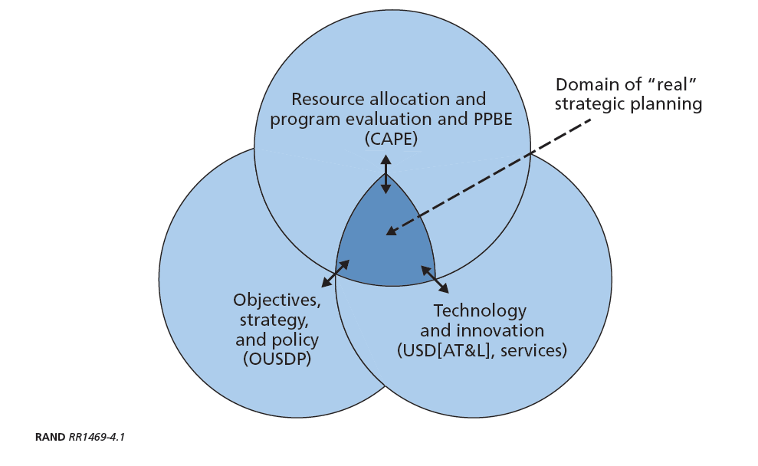
Domain of Strategic Planning
If and When
Why
What and How
Organizations listed are the major U.S. DoD organizations involved in defense resource allocation.

Slide 7
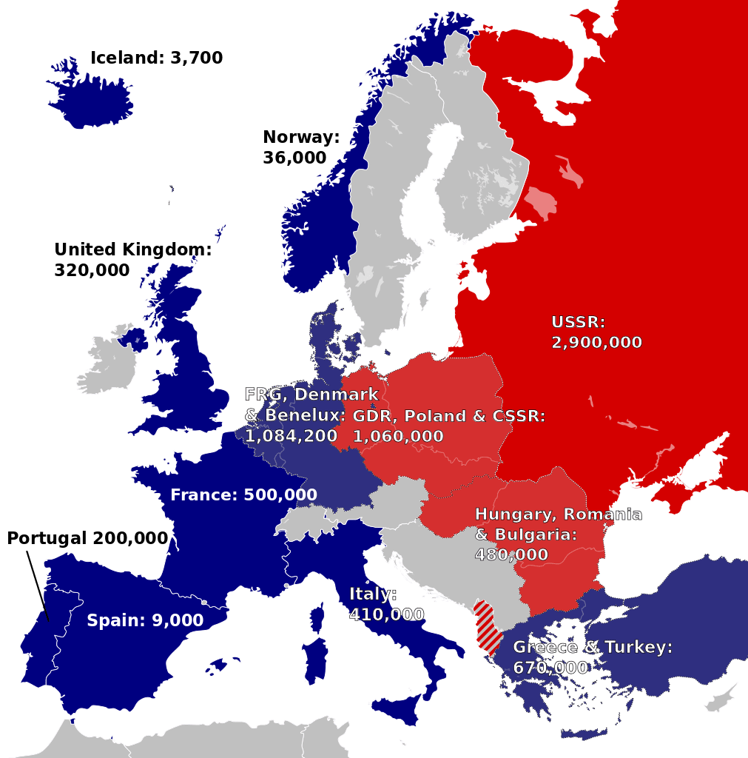
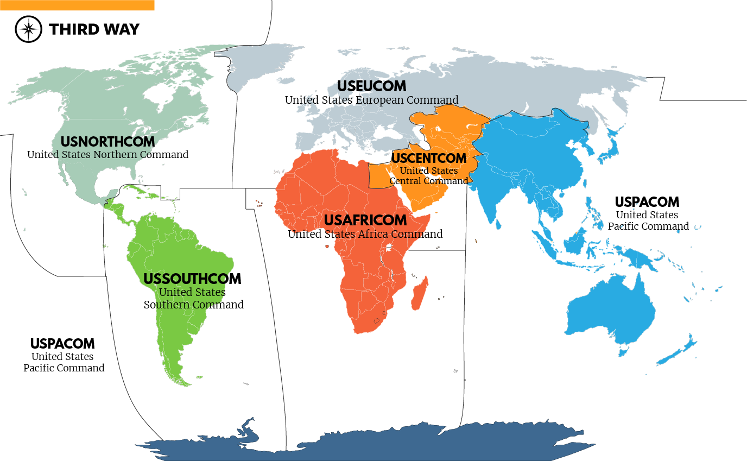
Post World War 2 Strategic Planning Approaches
Cold War Scenario Analysis
Post-Cold War Major Regional Conflicts
Capabilities-Based Planning

Slide 8
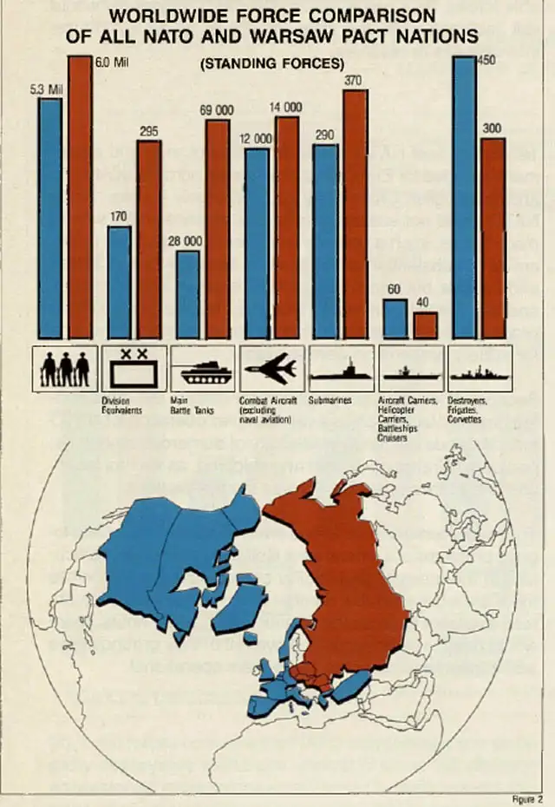
Cold War Scenario Analysis
Useful for assessing capabilities and new capabilities.
Dependent on intelligence about adversary capabilities and intent.
Force Comparison, NATO and the Warsaw Pact, 1987, via the North Atlantic Treaty Organization
November 9, 1989. Berlin Wall falls.

Slide 9
U.S. Major Regional Commands

Slide 10
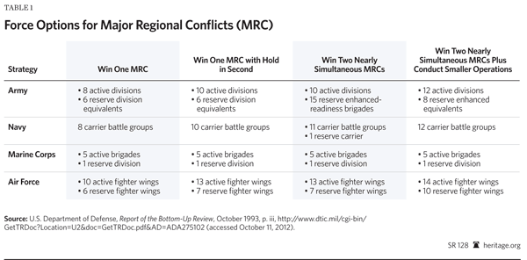
Post Cold War
Major Regional Conflicts
Useful for assessing total capabilities but less useful for new capabilities without specific scenarios and knowledge of potential adversary capabilities and intent.

Slide 11

Capabilities-Based Planning
Paul K. Davis
A great idea that is hard to implement in a bureaucracy.
2002
2016

Slide 12
Overview
Strategic planning for military resource allocation
Capabilities-Based Planning (CBP)
Value-Focused Thinking (VFT)
VFT for CBP
Integrated modeling and analysis

Slide 13
What is Capabilities-Based Planning?
identifying capability needs
assessing capability options for effectiveness in stressful building-block missions (i.e., operations)
making choices about requirements and ways to achieve them, and doing so in an integrative portfolio framework that addresses future war-fighting capabilities, force management, risk tradeoffs, and related matters in an economic framework.
Capabilities-based planning (CPB) is planning, under uncertainty, to provide capabilities suitable for a wide range of modern-day challenges and circumstances while working within an economic framework that necessitates choice. It contrasts with developing forces based on a specific threat and scenario.
Adopted by DoD in 2001.

Slide 14
Role of Mission System Analysis
CBP Implementation Challenges
  How do we identify the missions
  How do we define capabilities?
  How do we measure capabilities?
  How do we identify the capability options?
  How do we define the scenario space?
  How do we identify the capability gaps?
  What models should we use?
  Where do we get the data to evaluate?

Slide 15
Overview
Strategic planning for military resource allocation
Capabilities-Based Planning (CBP)
Value-Focused Thinking (VFT)
VFT for CBP
Integrated modeling and analysis

Slide 16

Value-Focused Thinking
Alternative-Focused Thinking
  Problem arises
  Problem solving begins
  Alternative solutions listed
  Specify evaluation criteria
  Evaluate alternatives
  Select best alternative
Keeney, R. Value Focused Thinking. Harvard University Press. 1992.
Value-Focused Thinking
  Problem or opportunity
  Determine your objectives
  Develop creative alternatives
  Evaluate alternatives
  Create better alternatives
  Select best alternative
Which approach best aligns with CBP?

Slide 17
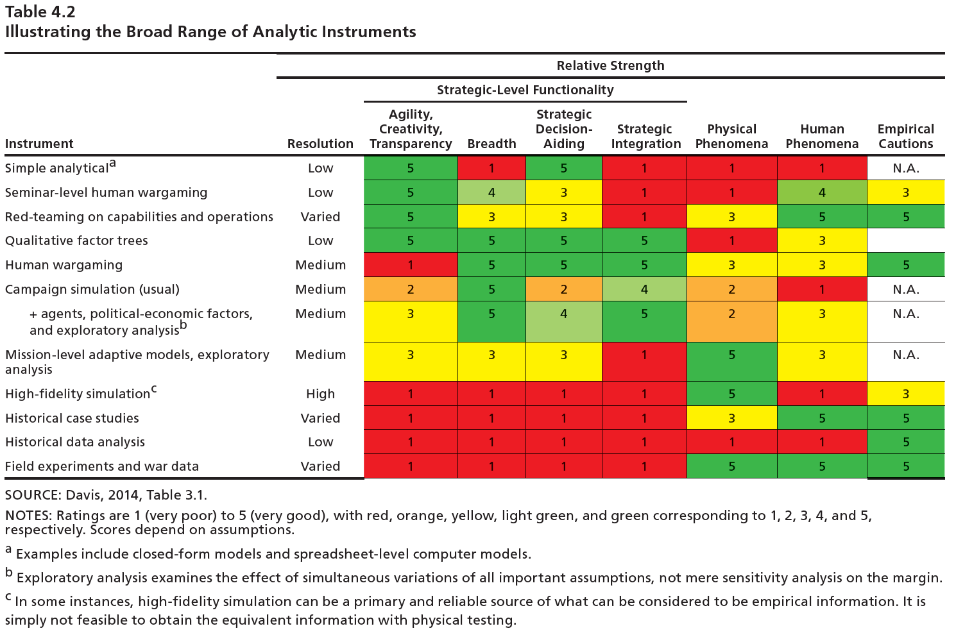
Many Analytic Tools
No one tool is fully adequate for CBP.
Paul K. Davis

Slide 18
There are several benefits of VFT
These benefits align with the needs for CBP!

Slide 19
Overview
Strategic planning for military resource allocation
Capabilities-Based Planning (CBP)
Value-Focused Thinking (VFT)
VFT for CBP
Integrated modeling and analysis

Slide 20
Requirements for VFT for CBP
Critical thinking about the missions
  What functions are required
  What performance do we value
Creative thinking about alternatives
Consideration of uncertainties
Integrated modeling of performance and cost
Best available models and data
Analysis tools that provide insights to decision makers

Slide 21
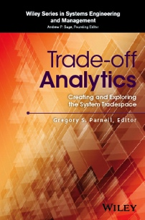
Functional Value Model to
Evaluate UAS Operations
Small Unmanned Aeronautical System (UAS )
Transport UAS
Minimize UAS weight
Minimize UAS volume
Survive in flight
Minimize acoustic signature
Launch UAV
Collect data
Sustain operations
Minimize # of people required to launch
Minimize launch support equipment
Minimize visual signature
Minimize thermal signature
Maximize range of UAV
Minimize time to target
Maximize probability of target detection
Maximize all-weather capability
Recover UAV
Maximize reliability
Maximize endurance
Maximize probability of recovery
Minimize time to destroy if not recoverable
Functions
A. MacCalman, G. Parnell and S. Savage, “An Integrated Model for Trade-off Analysis,” Trade-off Analytics: Creating and Evaluating the Tradespace, G. Parnell, Editor, Wiley & Sons, 2016.
Value Measures

Slide 22

Uncertainties in System Decisions
Uncertainties must be considered in all system decisions throughout the life cycle
Uncertainties include:
  Stakeholder needs
  Technological maturity
  Adversary and competition actions
  Scenarios
  Costs
  Schedules
  …many more

Slide 23
Overview
Strategic planning for military resource allocation
Capabilities-Based Planning (CBP)
Value-Focused Thinking (VFT)
VFT for CBP
Integrated modeling and analysis

Slide 24
Integrated Model using an Influence Diagram
A. MacCalman, G. Parnell and S. Savage, “An Integrated Model for Trade-off Analysis,” Trade-off Analytics: Creating and Evaluating the Tradespace, G. Parnell, Editor, Wiley & Sons, 2016.
Systems decisions involve significant uncertainties and an integrated trade-off analysis requires both value and cost analysis.

Slide 25
Decisions
Requirements
  Describe the technical capabilities and levels of performance that a system must have and any constraints on the system.
Functions
  An action that transforms inputs and generates outputs, involving data, materials, and/or energies (SEBoK, 2019).
  Identify system functions required to achieve the objectives
Objectives
  Determine what that we desire to achieve
System Alternatives
  Identify concept and design decisions
A. MacCalman, G. Parnell and S. Savage, “An Integrated Model for Trade-off Analysis,” Trade-off Analytics: Creating and Evaluating the Tradespace, G. Parnell, Editor, Wiley & Sons, 2016.

Slide 26
Uncertainty Nodes (1 of 4)
Key uncertainties:
  Stakeholder needs
  Scenarios
  Adversary/Competition actions
  Priorities
  Technological maturity
  System models
  System features
  Value measure data (system performance)
  Resources (cost)
A. MacCalman, G. Parnell and S. Savage, “An Integrated Model for Trade-off Analysis,” Trade-off Analytics: Creating and Evaluating the Tradespace, G. Parnell, Editor, Wiley & Sons, 2016.

Slide 27
Uncertainty Nodes (2 of 4)
Stakeholder Needs
  Statements that express what they think the system should be able to do from their perspective.
Adversary / Competition
  Involves the external factors that influence the outcome of a scenario
Scenarios
  Use cases of the system in given conditions
A. MacCalman, G. Parnell and S. Savage, “An Integrated Model for Trade-off Analysis,” Trade-off Analytics: Creating and Evaluating the Tradespace, G. Parnell, Editor, Wiley & Sons, 2016.

Slide 28
Uncertainty Nodes (3 of 4)
Priorities
  In a multiple-objective decision model, priorities are instantiated using swing weights.
Technological Maturity
  System designers use new technologies to achieve improved performance and/or reduced cost
  TRL are biased
System Features
  Characteristics or design parameters that define each alternative
A. MacCalman, G. Parnell and S. Savage, “An Integrated Model for Trade-off Analysis,” Trade-off Analytics: Creating and Evaluating the Tradespace, G. Parnell, Editor, Wiley & Sons, 2016.

Slide 29
Uncertainty Nodes (4 of 4)
System Models
  Critical to understanding the behavior of a system, especially in the early stages of the life cycle.
  Models are abstractions of reality, they must be verified and validated so they can accurately inform the system decision
Value Measure Data
  Estimates of the performance of system alternatives in scenarios using system models
Resources (Cost)
  Estimates of the resources based on the system features using cost models
A. MacCalman, G. Parnell and S. Savage, “An Integrated Model for Trade-off Analysis,” Trade-off Analytics: Creating and Evaluating the Tradespace, G. Parnell, Editor, Wiley & Sons, 2016.

Slide 30
Value Nodes
Represents the total value or total life cycle cost of an alternative
A. MacCalman, G. Parnell and S. Savage, “An Integrated Model for Trade-off Analysis,” Trade-off Analytics: Creating and Evaluating the Tradespace, G. Parnell, Editor, Wiley & Sons, 2016.

Slide 31
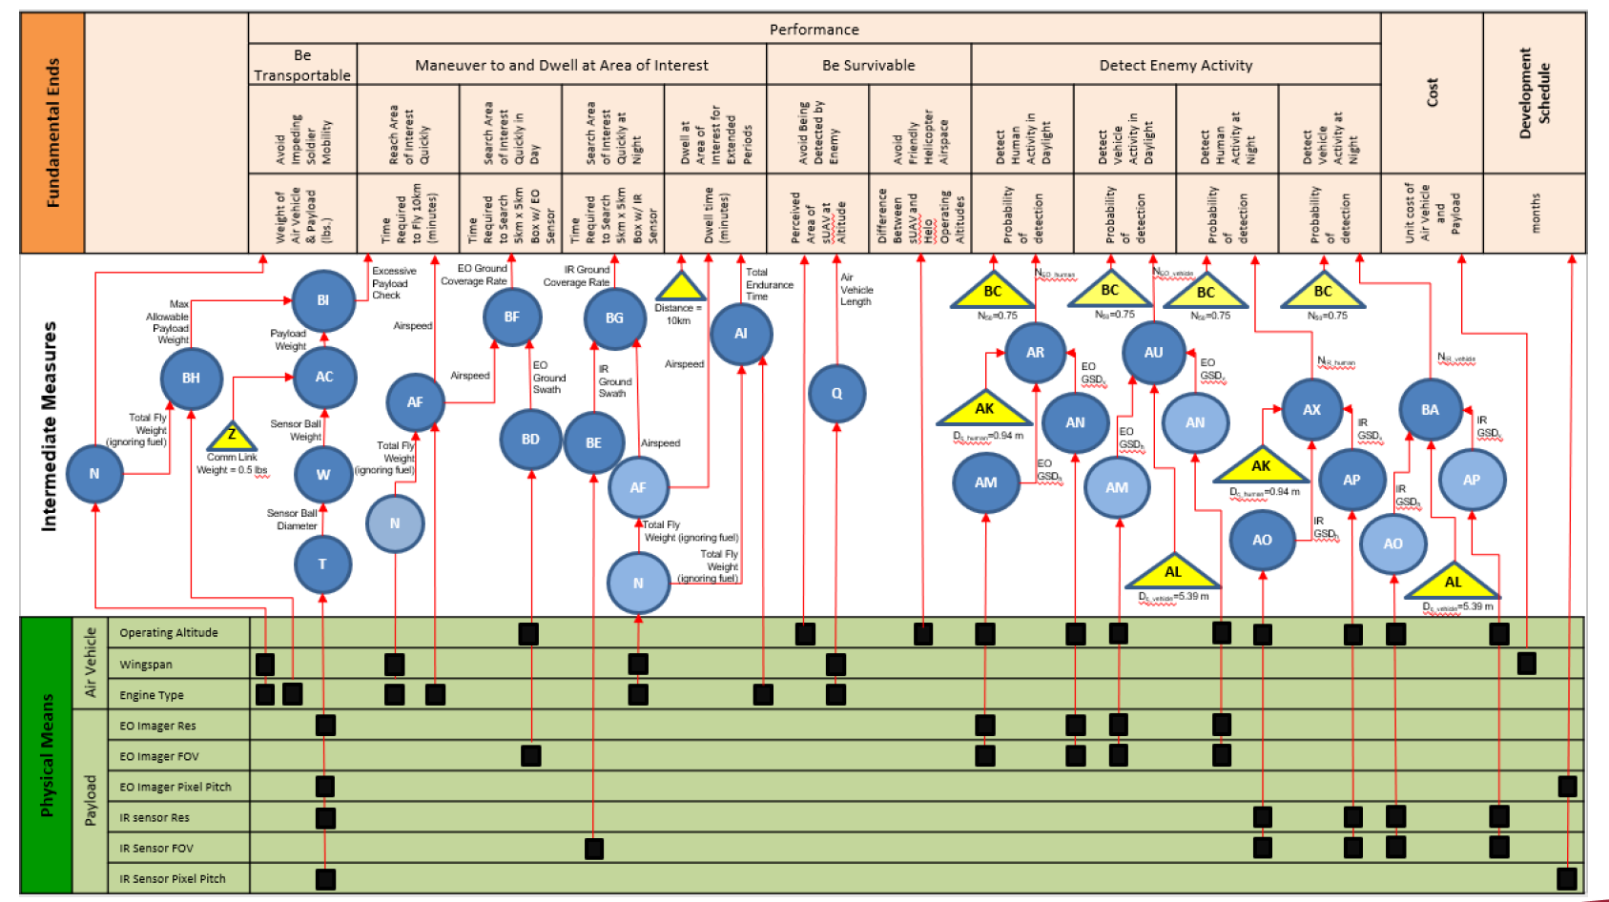
Assessment Flow Diagram in Integrated Modeling
The assessment flow diagram shows the role of integrated models in evaluating designs versus the value measures.
Matt Cilli, Trade-off Analytics: Creating and Evaluating the Tradespace, G. Parnell, Editor, Wiley & Sons, 2016.

Slide 32
Functional Value Model to
Evaluate UAS Operations
Small Unmanned Aeronautical System (UAS )
Transport UAS
Minimize UAS weight
Minimize UAS volume
Survive in flight
Minimize acoustic signature
Launch UAV
Collect data
Sustain operations
Minimize # of people required to launch
Minimize launch support equipment
Minimize visual signature
Minimize thermal signature
Maximize range of UAV
Minimize time to target
Maximize probability of target detection
Maximize all-weather capability
Recover UAV
Maximize reliability
Maximize endurance
Maximize probability of recovery
Minimize time to destroy if not recoverable
Functions
A. MacCalman, G. Parnell and S. Savage, “An Integrated Model for Trade-off Analysis,” Trade-off Analytics: Creating and Evaluating the Tradespace, G. Parnell, Editor, Wiley & Sons, 2016.
Value Measures

Slide 33
The additive value model is used to mathematically define value and to evaluate alternatives.
Swing weights for each value measure i assess importance and variation
Total Value of the Alternative
10
V_{i}( x_{i})
Normalized Swing weights sum to 1
Value function for each measure i: assess returns to scale and provide a ‘common currency’ across all measures
0
xº_{i}
x_{i}
x*_{i}
Score on value measure i
Keeney, R.L. and Raiffa H. Decision Making with Multiple Objectives Preferences and Value Tradeoffs. New York: Wiley, 1976.
The additive value model is the most common value model. The equation is the same for all alternatives.

Slide 34
Value functions define stakeholder-assessed value returns for each measure for each objective
Four shapes are common
Value functions may be continuous or discrete.
Value functions are usually scaled from
  0 to 1
  0 to 10
  0 to 100
Requirements become the minimum acceptable (x_{i}º )levels for each value function.
Best Practice: Get expert agreement on the shape of the curve (and rationale), then get the numbers.
The value curves show the value of each performance increment.

Slide 35
Best practice for weights: The swing weight matrix.
 |  | Importance of the value measure to the decision makers and stakeholders (intuitive)
 |  | High | Medium | Low
The capability gap between the minimum acceptable and the idea. (factual) | High
 | Medium
 | Low
The swing weight matrix identifies the importance of the capabilities and the capability gaps.
Weights depend on the importance of the value measure to the decision maker and stakeholders and the range of the value measure.
Explaining range variation is difficult because we routinely make intuitive judgments about importance without the impact of the actual variation of the value measure range for the decision under consideration.
The definition of importance and range variation will be different for each decision and requires hard thinking. The task is similar to defining two constructed scales.
Range variation may be easier to discuss as the “impact of the value measure changes on the decision,” or analogously as “impact on capability gap.”
Parnell, G., Bresnick, Johnson, E., & Tani, S., Handbook of Decision Analysis, OR/MS Handbook Series, Wiley & Sons, 2013
35

Slide 36
The swing weight matrix requires some consistency rules.
 |  | Importance of the value measure to the decision
 |  | High* | Medium | Low
Impact of the value measure range variation | High | A | B₂ | C₃
 | Medium | B₁ | C₂ | D₂
 | Low | C₁ | D₁ | E
Weights in the following cells need to follow the ‘right and down’ relationship:
A > all other cells
B₁ > C₁, C₂, D₁, D₂, E
B₂ > C₂, C₃, D₁, D₂, E
C₁ > D₁, E
C₂ > D₁, D₂, E
C₃ > D₂, E
D₁ > E
D₂ > E
Multiple measures can be placed in the same cell with same or different weights.
* Some prefer to put High in upper right hand corner.
Parnell, G., Bresnick, Johnson, E., & Tani, S., Handbook of Decision Analysis, OR/MS Handbook Series, Wiley & Sons, 2013

Slide 37
The swing weight matrix help assess the value measure weights.
 |  | Importance of the value measure to the decision
 |  | High* | Medium | Low
Impact of the value measure range variation | High | Measure X f₁ = 100
 | Medium
 | Low |  |  | Measure Y f₉ = 1
= non-normalized matrix swing weight corresponding to value measure i.
normalized swing weight corresponding to value measure i.
Once the levels of importance and range variation are assessed, all the measures are placed in the cells.
One measure is assigned an arbitrary non-normalized weight (e.g., 100, 1000). The highest or lowest weighted cells are the best place to start.
Any swing weight technique can be used, e.g. balance beam or value increment to assess the remaining weights.
Swing weights are obtained by normalizing the weights.
Parnell, G., Bresnick, Johnson, E., & Tani, S., Handbook of Decision Analysis, OR/MS Handbook Series, Wiley & Sons, 2013

Slide 38
Total Value Calculations using MODA
Can be calculated based on decision, the value measure score, the value functions, and the priorities (swing weights) using the additive value model.
One way to choose alternative of greatest value: Value Component Chart
Figure 9.4. Value component chart for the assault scenario
Value Component Chart shows the value contribution for each value measure.
A. MacCalman, G. Parnell and S. Savage, “An Integrated Model for Trade-off Analysis,” Trade-off Analytics: Creating and Evaluating the Tradespace, G. Parnell, Editor, Wiley & Sons, 2016.

Slide 39
Cost versus Value Trade-off Analysis
The total cost value node is the estimated total life cycle cost for each alternative.
Cost is treated as an independent variable, not a value measure
Pareto Chart: Assists in understanding the trade-offs between value and cost for the alternatives considered
Figure 9.5 Deterministic Pareto Chart for the assault scenario
A. MacCalman, G. Parnell and S. Savage, “An Integrated Model for Trade-off Analysis,” Trade-off Analytics: Creating and Evaluating the Tradespace, G. Parnell, Editor, Wiley & Sons, 2016.
The deterministic Pareto chart provides information to identify dominated alternatives, e.g., Sustainable and Survivable.

Slide 40
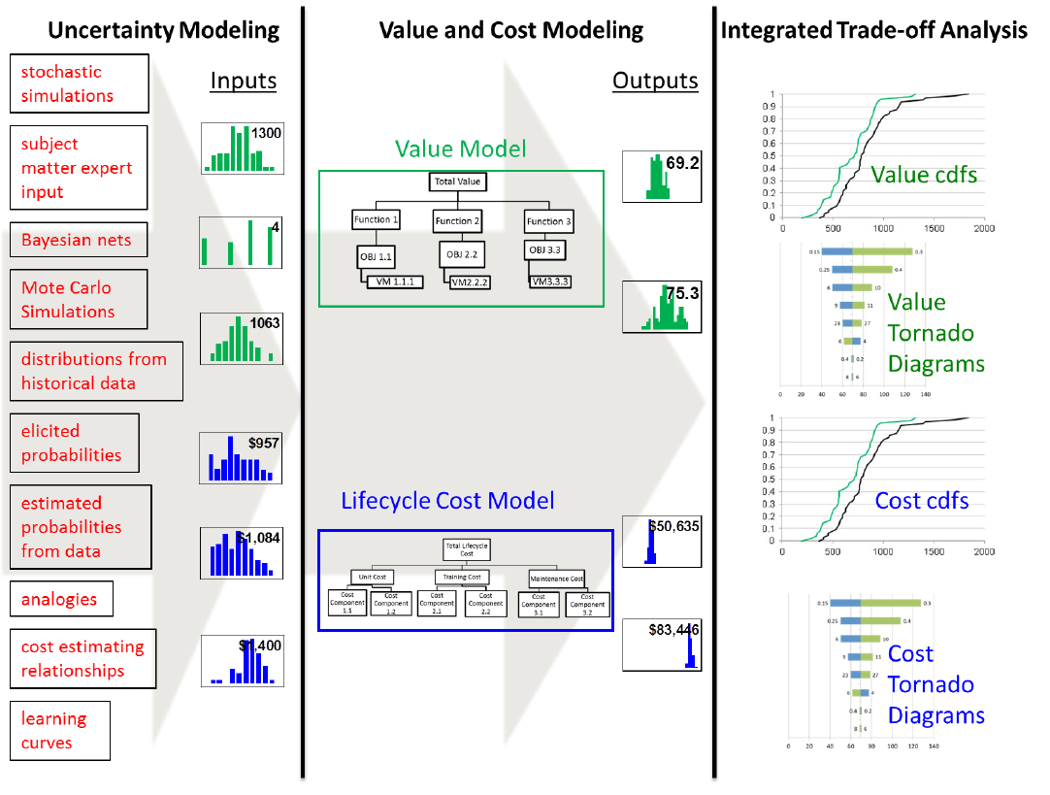
Integrated Modeling
Monte Carlo Simulation can be used to assess the uncertainties.
An integrated model allows for decision-makers to better understand value and cost risk of the alternatives.
Figure 9.6, A. MacCalman, G. Parnell and S. Savage, “An Integrated Model for Trade-off Analysis,” Trade-off Analytics: Creating and Evaluating the Tradespace, G. Parnell, Editor, Wiley & Sons, 2016.

Slide 41
Stochastic Pareto Chart
An integrated model allows for decision-makers to better understand value and cost risk of the alternatives.
A. MacCalman, G. Parnell and S. Savage, “An Integrated Model for Trade-off Analysis,” Trade-off Analytics: Creating and Evaluating the Tradespace, G. Parnell, Editor, Wiley & Sons, 2016.

Slide 42
Cumulative Distribution Function (S-Curve) Charts
An integrated model allows for decision-makers to better understand value (and cost) risk of the alternatives.
A. MacCalman, G. Parnell and S. Savage, “An Integrated Model for Trade-off Analysis,” Trade-off Analytics: Creating and Evaluating the Tradespace, G. Parnell, Editor, Wiley & Sons, 2016.

Slide 43
Sensitivity Analysis: Tornado Diagrams
The tornado diagram identifies the variable that cause the most variation in value and cost.
A. MacCalman, G. Parnell and S. Savage, “An Integrated Model for Trade-off Analysis,” Trade-off Analytics: Creating and Evaluating the Tradespace, G. Parnell, Editor, Wiley & Sons, 2016.

Slide 44
Summary
Post Cold War Strategy for Resource Allocation
Capabilities-Based Planning
Value-Focused Thinking
Value Models
Integrated Analysis Models
Trade-Off Analytics

