Slide 1
Competency-based Training to Address
Representative Engineering Grand Challenges
Girum Urgessa, Ph.D., P.E., F.ASCE
Associate Professor
09/27/2023
Notes:
1

Slide 2
Outline
NAE Grand Challenges
Cross-cutting Themes
  Sustainability
  Security
  Health
  Joy of Living
Simple Teaching Example
Notes:
2

Slide 3
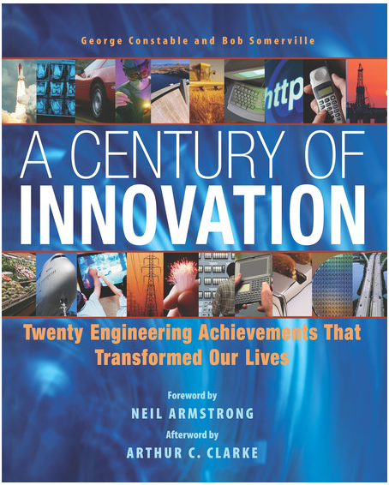
NAE Grand Challenges
National Academy of Engineers (NAE) +
American Association of Eng. Societies (AAES)
-1998
  The most important engineering contributions from the 20th century
  The list includes 20 achievements
Joseph Henry Press
Notes:
3

Slide 4
NAE Grand Challenges
National Academy of Engineers (NAE)
  Private, independent, nonprofit institution
  Provides engineer leadership in service to the nation
  Independent advice on matters involving engineering and technology
Notes:
4

Slide 5
NAE Grand Challenges
Greatest Engineering Achievements of the 20th Century
Electrification | Highways
Automobile | Spacecraft
Airplane | Internet
Water Supply and Distribution | Imaging
Electronics | Household Appliances
Radio and Television | Health Technologies
Agricultural Mechanization | Petroleum and Petrochemical Technologies
Computers | Laser and Fiber Optics
Telephone | Nuclear Technologies
Air Conditioning | High-performance Materials
Notes:
5

Slide 6
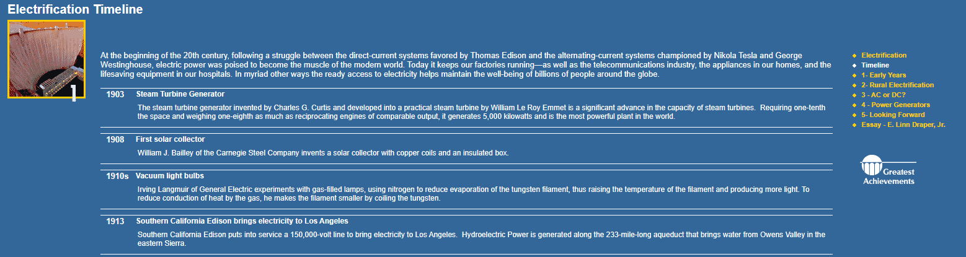
NAE Grand Challenges
Electrification
www.greatachivements.org
Notes:
6

Slide 7
NAE Grand Challenges
NAE + National Science Foundation (NSF) initiative - 2006
  International experts set to identify important engineering challenges of the 21st century
  Focus on larger societal concepts
  “not just thinking about what could be invented but rather focused on what needed to be developed”
Notes:
7

Slide 8
NAE Grand Challenges
Two main goals of the NAE + NSF initiative - 2006
  Orients public attention to the role of engineers in society
  Serves as an organizing framework in engineering
Notes:
8

Slide 9
NAE Grand Challenges
NAE + NSF initiative output
  NAE Grand Challenges for Engineering in the 21st Century
  14 game-changing goals for improving life on the planet
  4 cross-cutting themes
Notes:
9

Slide 10
NAE Grand Challenges
Questions
    Think about 2-3 major engineering challenges that the world in general is facing or will face in this century?
    What about in the Brazilian context?
Notes:
10

Slide 11
Outline
NAE Grand Challenges
Cross-cutting Themes
  Sustainability
  Security
  Health
  Joy of Living
Simple Teaching Example
Notes:
11

Slide 12
Cross-cutting Themes
4 cross-cutting themes
Sustainability
Security
Health
Joy of Living
Notes:
12

Slide 13
Cross-cutting Themes
Sustainability
  Our ability to occupy this planet continuously
Security
  Guaranteeing security from major threats and hazards
Health
  Promoting healthy living
Joy of living
  Enhancing joy, and depth to human existence and understanding
Notes:
13

Slide 14
Outline
NAE Grand Challenges
Cross-cutting Themes
  Sustainability
  Security
  Health
  Joy of Living
Simple Teaching Example
Notes:
14

Slide 15
Sustainability-dominating Themes
1. Develop carbon sequestration methods
  Sequestration is capturing CO₂ and storing it safely away from the atmosphere or reuse it to produce products such as concrete
    Point-source capture (e.g. industrial facility)
    Atmospheric or direct air capture
  While methods exist, opportunities exist for improvement
Notes:
15

Slide 16
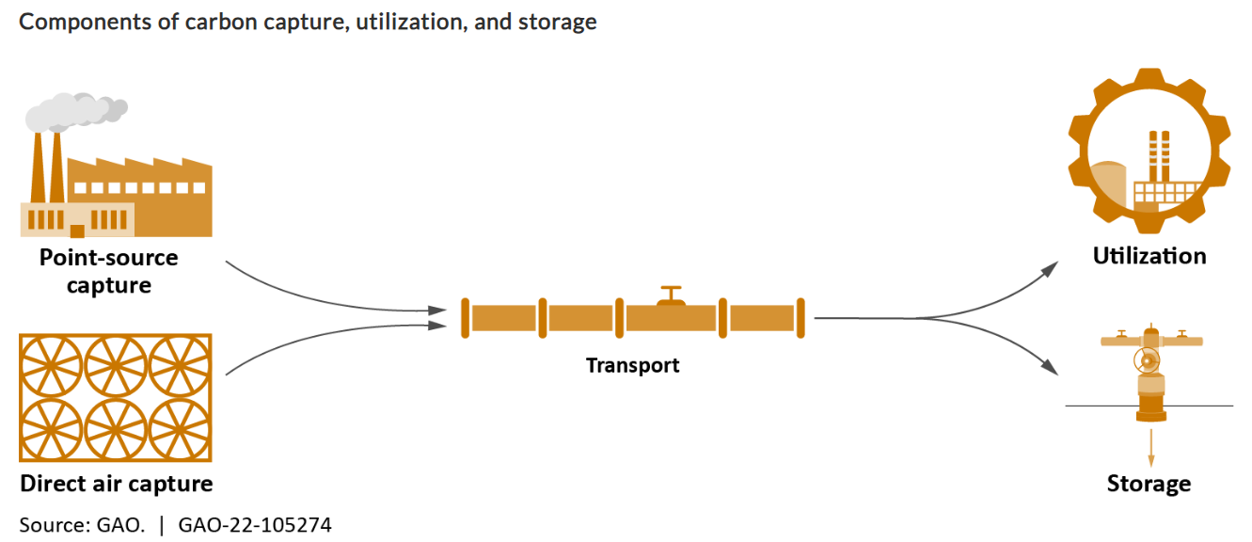
Sustainability-dominating Themes
Notes:
16

Slide 17
Sustainability-dominating Themes
Carbon capture, utilization, and storage (CSUS) still has several challenges
  Cost
  Infrastructure development
  Community engagement
Notes:
17

Slide 18
Sustainability-dominating Themes
Policy considerations
  Research development and demonstration
  Technology-neutral standards
  Standardize life cycle assessment guidelines
  Framework for land access
  Strategic siting
  Modify incentives
  Community engagement
Notes:
18

Slide 19
Sustainability-dominating Themes
Question
    In the Brazilian context, what challenges or opportunities exist for developing carbon sequestration methods?
Notes:
19

Slide 20
Sustainability-dominating Themes
2. Manage the nitrogen cycle
  Human activity has caused significant increase in nitrogen presence
  Leading to worsening GH effect, reducing the protective ozone layer, adding to smog, contributing to acid rain, and contaminating water
  Fertilizers and farming have played a central role in boosting worldwide food production; How to balance it with denitrification?
Notes:
20

Slide 21
Sustainability-dominating Themes
Sources of excess nitrogen
  Agriculture
  Stormwater
  Wastewater
  Fossil fuels
  In and around the home
Notes:
21

Slide 22
Sustainability-dominating Themes
Innovation in the following areas are needed
  Ensuring that a higher percentage of the fertilizers ends up in the plants as organic nitrogen
  Reducing runoff, leaching, and erosion that carry nitrogen fertilizer away from the plants and into groundwater
  Reducing the gas emissions from soils and water systems
Notes:
22

Slide 23
Sustainability-dominating Themes
Question
    In the Brazilian context, what challenges or opportunities exist for managing the nitrogen cycle?
Notes:
23

Slide 24
Sustainability-dominating Themes
3. Make solar energy economical
  Energy security, alternative to fossil fuels, environmentally cleaner
  Share of solar in the total energy market can be improved
  Specifics
    Making solar cell designs cheaper
    Storing the energy for later use
Notes:
24

Slide 25
Sustainability-dominating Themes
Question
    In the Brazilian context, what challenges or opportunities exist for making solar energy economical?
Notes:
25

Slide 26
Sustainability-dominating Themes
4. Restore and improve urban infrastructure
  Broad definition of infrastructure
  Building better infrastructure
    Novel materials
    Advances in CS and robotics – automation in construction
Notes:
26

Slide 27
Sustainability-dominating Themes
Question
    In the Brazilian context, what challenges or opportunities exist for restoring and improving urban infrastructure?
Notes:
27

Slide 28

Sustainability-dominating Themes
5. Provide access to clean water
http://www.engineeringchallenges.org/challenges/water.aspx
Notes:
28

Slide 29
Sustainability-dominating Themes
Question
    In the Brazilian context, what challenges or opportunities exist for providing access to clean water or is access to clean water no problem at all?
Notes:
29

Slide 30
Sustainability-dominating Themes
6. Provide energy from fusion
  Enormous heat and gravitational pressure compress the nuclei of certain atoms into heavier nuclei, releasing energy
  Building full-scale fusion-generating facilities requires eng. advances, e.g. better superconducting magnets and advanced vacuum systems
  Fusion fuels offer the irresistible combination of abundant supply with minimum environmental consequences
Notes:
30

Slide 31
Sustainability-dominating Themes
Question
    In the Brazilian context, what challenges or opportunities exist for providing energy from fusion?
Notes:
31

Slide 32
Outline
NAE Grand Challenges
Cross-cutting Themes
  Sustainability
  Security
  Health
  Joy of Living
Simple Teaching Example
Notes:
32

Slide 33
Security-dominating Themes
7. Prevent nuclear terror
  Nuclear reactors for research or power are scattered around the globe, capable of producing the raw material for nuclear devices
  Challenges
    How to secure the materials?
    How to detect, especially at a distance?
    How to render a potential device harmless?
    Emergency response and cleanup
    Public communication after a nuclear explosion
    Determining who did it
Notes:
33

Slide 34
Security-dominating Themes
Question
    In the Brazilian context, is this a concern?
Notes:
34

Slide 35

Security-dominating Themes
8. Secure cyberspace
  Disruptions
    Serious breaches of cybersecurity in financial and military systems
    Identity theft
    Viruses and other cyber-attacks plague computers small and large and disrupt commerce and communication on the Internet
http://www.engineeringchallenges.org/challenges/cyberspace.aspx
Notes:
35

Slide 36
Outline
NAE Grand Challenges
Cross-cutting Themes
  Sustainability
  Security
  Health
  Joy of Living
Simple Teaching Example
Notes:
36

Slide 37

Health Themes
9. Reverse-engineer the brain
  Neurological disorders fixed by tech. innovations that allow wiring of new materials into our bodies to do the jobs of lost/damaged nerve cells
  Implanted electronic devices could help victims of dementia to remember, blind people to see, and crippled people to walk
http://www.engineeringchallenges.org/challenges/9109.aspx
Notes:
37

Slide 38
Health Themes
10. Engineer better medicine
  Ideally, doctors would be able to diagnose and treat people based on those individual differences, i.e. personalized medicine
  A comprehensive, prospective approach to preventing, diagnosing, treating, and monitoring disease in ways that achieve optimal individual health-care decisions
  There is a need to create inexpensive and rapid diagnostic devices such as gene chips and sensors able to detect small amounts of chemicals in the blood
Notes:
38

Slide 39
Health Themes
11. Advance health informatics
  The acquisition, management, and use of information in health — can greatly enhance the quality and efficiency of medical care and the response to widespread public health emergencies
  Information overload needs systematic electronic systems for finding information to treat specific patients and decision support systems to offer “just in time, just for me” advice at the point of care
Notes:
39

Slide 40
Health Themes
Question
    What major research activities are conducted in addressing grand challenges associated with health?
Notes:
40

Slide 41
Outline
NAE Grand Challenges
Cross-cutting Themes
  Sustainability
  Security
  Health
  Joy of Living
Simple Teaching Example
Notes:
41

Slide 42
Joy of living Themes
12. Advance personalized learning
  Problem
    Single-set of instructions provided identically to every student
    Differences in aptitude or interest
  Personal learning approaches ranging from
    Modules that students can master at their own pace
    Computer programs designed to match the way it presents content with a learner’s personality
Notes:
42

Slide 43
Joy of living Themes
13. Enhance virtual reality
“Rendering of a virtual human that can purposefully interact with a real person — for example, through speech recognition, the generation of meaningful sentences, facial expression, emotion, skin color and tone, and muscle and joint movements — is still beyond the capabilities of real-time computer graphics and artificial intelligence,” write neuroscientist Maria V. Sanchez-Vives and computer scientist Mel Slater. [Sanchez-Vives, p. 335]
Notes:
43

Slide 44
Joy of living Themes
Question
    Have we already moved on from the “enhancing” phase?
Notes:
44

Slide 45
Joy of living Themes
14. Engineer the tools of scientific discovery
  Engineers and scientist will come together often to solve many unanswered problems
  Old thinking
    Scientist: Explore, experiment, discover
    Engineer: Create, design, build
Notes:
45

Slide 46
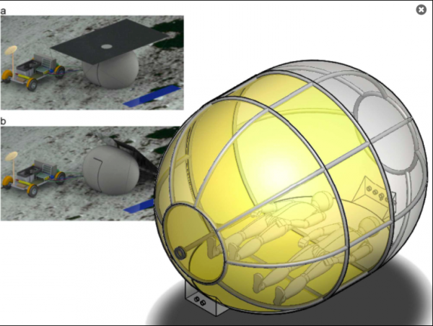
Joy of living Themes
Astronauts have walked on the moon, roamed it, and explored it
Can they camp on it for days at a time to make their trips worthwhile?
http://www.engineeringchallenges.org/challenges
Notes:
46

Slide 47
Joy of living Themes
Biologists are always seeking, for instance, better tools for imaging the body and the brain
They will depend on engineering help — perhaps in the form of new kinds of microscopes, or new biochemical methods of probing the body’s cellular and molecular machinations
Systems biology or synthetic biology may prove to enable the design of entirely novel biological chemicals and systems
Notes:
47

Slide 48
NAE Grand Challenges - Summary
Develop carbon sequestration methods | Secure cyberspace
Manage the nitrogen cycle | Reverse-engineer the brain
Make solar energy economical | Engineer better medicine
Restore and improve urban infrastructure | Advance health informatics
Provide access to clean water | Advance personalized learning
Provide energy from fusion | Enhance virtual reality
Prevent nuclear terror | Engineer the tools of discovery
Notes:
48

Slide 49
NAE Grand Challenges - Summary
Questions (Are your answers remain the same?)
    Think about 2-3 major engineering challenges that the world in general is facing or will face in this century?
    What about in the Brazilian context?
Notes:
49

Slide 50
Outline
NAE Grand Challenges
Cross-cutting Themes
  Sustainability
  Security
  Health
  Joy of Living
Simple Teaching Example
Notes:
50

Slide 51
Simple Teaching Example
Competency-based education
  Focus is placed on deep understanding that is demonstrated through application
  Learning outcomes are proven by action and focus on building the skills students need to become better learners into adulthood
  American Society for Engineering Education (ASEE) examples
Notes:
51

Slide 52
Simple Teaching Example
Arizona State University Example (Zhu and Trowbridge)
  2 credit: Intro to Engineering course
  Multidisciplinary hands-on team design; Real world problems
  Teams worked through
    the engineering design process to design a solution to the problem
    build a functional prototype of their solution
    test their prototype to demonstrate the effectiveness of their solution
Notes:
52

Slide 53
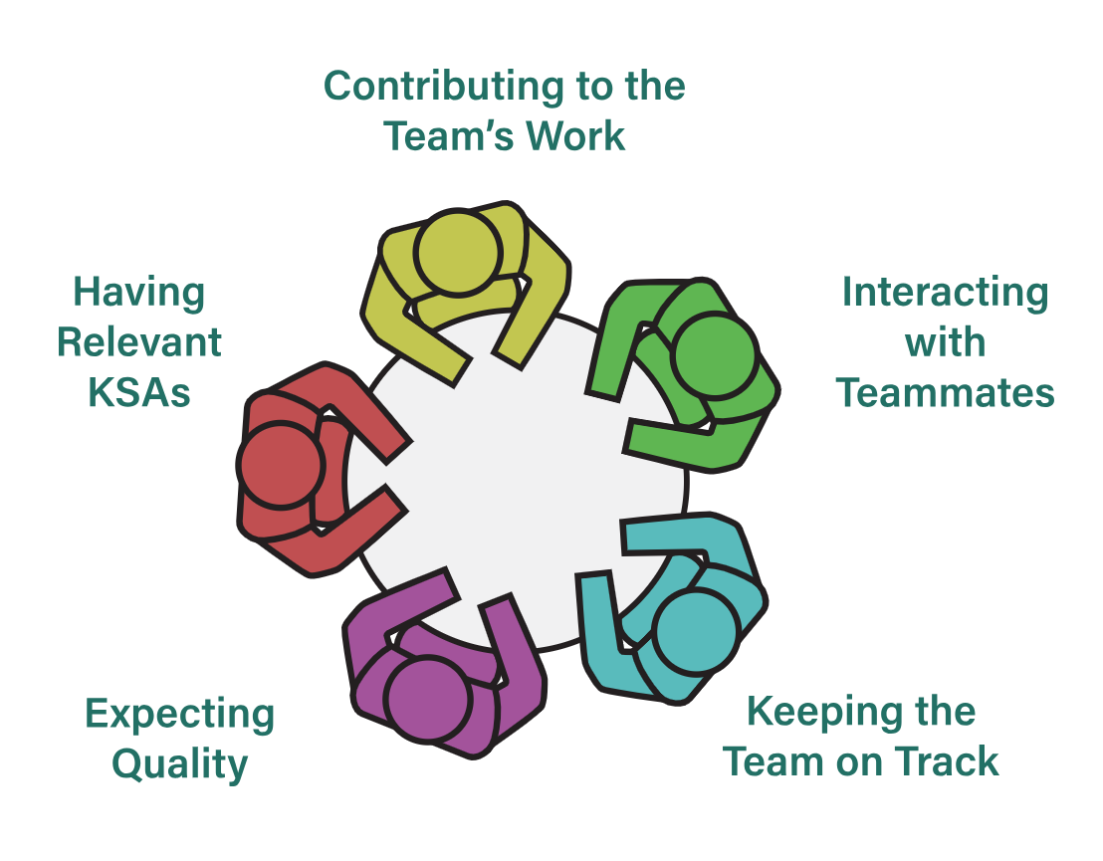
Simple Teaching Example
Intentional team formation
  Teams of 3 or 4
  CATME SMARTER teamwork
https://info.catme.org/
Notes:
53

Slide 54
Simple Teaching Example
Provide access to clean water | Design an inexpensive commercializable system that addresses the issues of transportation and purification of water from an open pond in the village Mawanga of Uganda
Make solar energy economical | Design, build, and test a solar power plant at relatively low cost that could provide consistent electrical power throughout the day for villagers living next to the Taklamakan desert in China
Advanced personalized learning | Create fun and interactive educational exhibits or toys for a community science center to teach a scientific principle of their choice to people with different learning styles
Notes:
54

Slide 55
Simple Teaching Example
Why select rural areas around the world?
  Provide students with opportunity to consider real needs of communities that they are not familiar with
  To help them better understand how engineering solution can be affected by realistic constrains (e.g. cost and resources)
Notes:
55

Slide 56
Simple Teaching Example
Intermediate deliverables
  Problem definition
  Project schedule
  Project proposal (oral + written)
  Progress report
Final deliverable
  Functional prototype
  Fina oral presentation
  Final written report
Notes:
56

Slide 57
Simple Teaching Example
Student feedback through surveys indicated that
  Solving problems in the NAE Grand Challenges framework
    has positively changed students’ perception on the roles engineers play and
    has positively changed students’ perception on the impact of engineering solutions in society
Notes:
57

Slide 58
Simple Teaching Example
Question
    How do you share best practices about competency-based education at ITA and other institutions?
Notes:
58

Slide 59
THANK YOU!
Notes:
59

