Slide 1
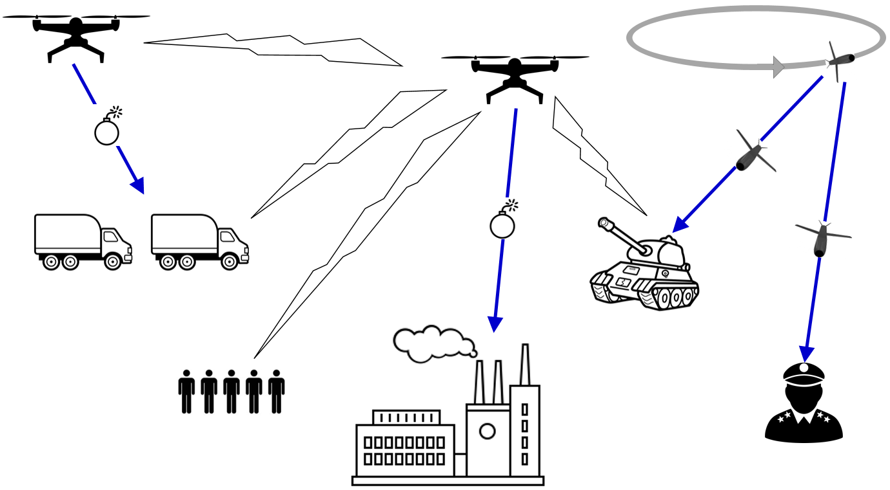
SARP A
SARP B
SARP C

